Slide 1




01
LeWagon x CareerCopilot
Helping learners not just study – but see where their skills can take them.
AI-Powered Career Recommendation App
Date - 24-04-2025
Presented by
Team Stack Underflow

Slide 2



Problems
02
Jobs Based On Skills?
Which Job is best ?
What To Do??
Which Skills Should I Improve?

Slide 3



Our Web App
03
•USER REGISTRATION AND LOGIN
•AI-BASED SKILL-TO-JOB MATCHING
• DREAM JOB-BASED SKILL GAP DETECTION
•LEARNING SUGGESTIONS FROM ROLE-SKILL MAPPINGS

Slide 4
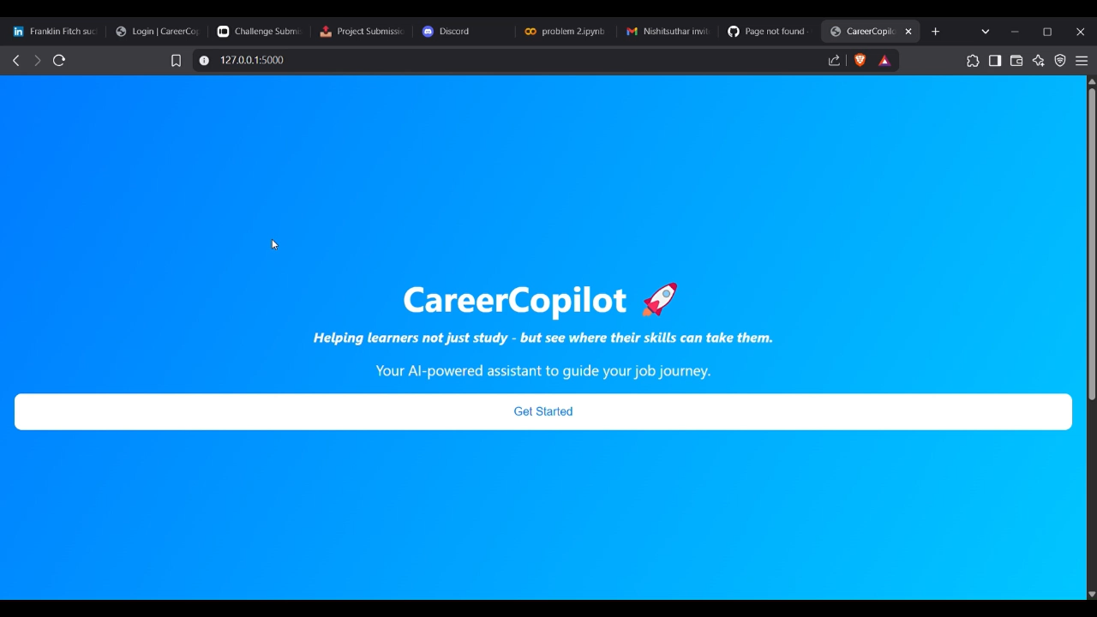
How it Works
4

Slide 5
Tech Stack
05
Python + Flask (Backend)(Rag Model)
SentenceTransformers (MiniLM model)
Pandas + Scikit-learn
HTML/CSS/JS (Frontend)
Excel & JSON (Data Storage)

Slide 6

Impact & Future Vision
6
Scalable for job seekers, bootcamp students, universities.
Potential integrations with LinkedIn, Indeed, LMS platforms.
Can evolve into a complete AI Career Copilot.

Slide 7

07

